Slide 1
GROUP DETAILS:
GROUP MEMBERS | TASK ALLOCATED
KHUSHI TRIVEDI (202312060) (GROUP LEADER) | FIREBASE, DOCUMENTATION
DHRUV PARMAR (202312059) | FIREBASE, DOCUMENTATION
ALKESH SHARMA(202312128) | FLUTTER (FRONTEND)
RUTVIK NAKUM (202312017) | FLUTTER (FRONTEND)

Slide 2
OBJECTIVES:
Develop a user-friendly mobile application, IEducation, to centralize and streamline college operations.
Provide administrators with tools for efficient management of student and staff information, course scheduling, examination management, library transactions, and financial tracking.
Enable students to access essential services conveniently, including registration, attendance tracking, assignment submission, fee payments, and academic resources.
Enhance communication between students and administrators through real-time notifications, announcements, and updates.
Improve transparency and accountability in college operations by centralizing data and providing secure access to authorized users.
Facilitate seamless integration with existing systems and databases to minimize disruption and ensure smooth transition.

Slide 3
Milestones:
User Authentication and Basic Functionality
Notices, Announcements, and Study Materials
Attendance Monitoring and Leave Management
Examination Results and Staff Management
Library Transactions and Fees Management
User Experience Improvements
Student Portal Features

Slide 4
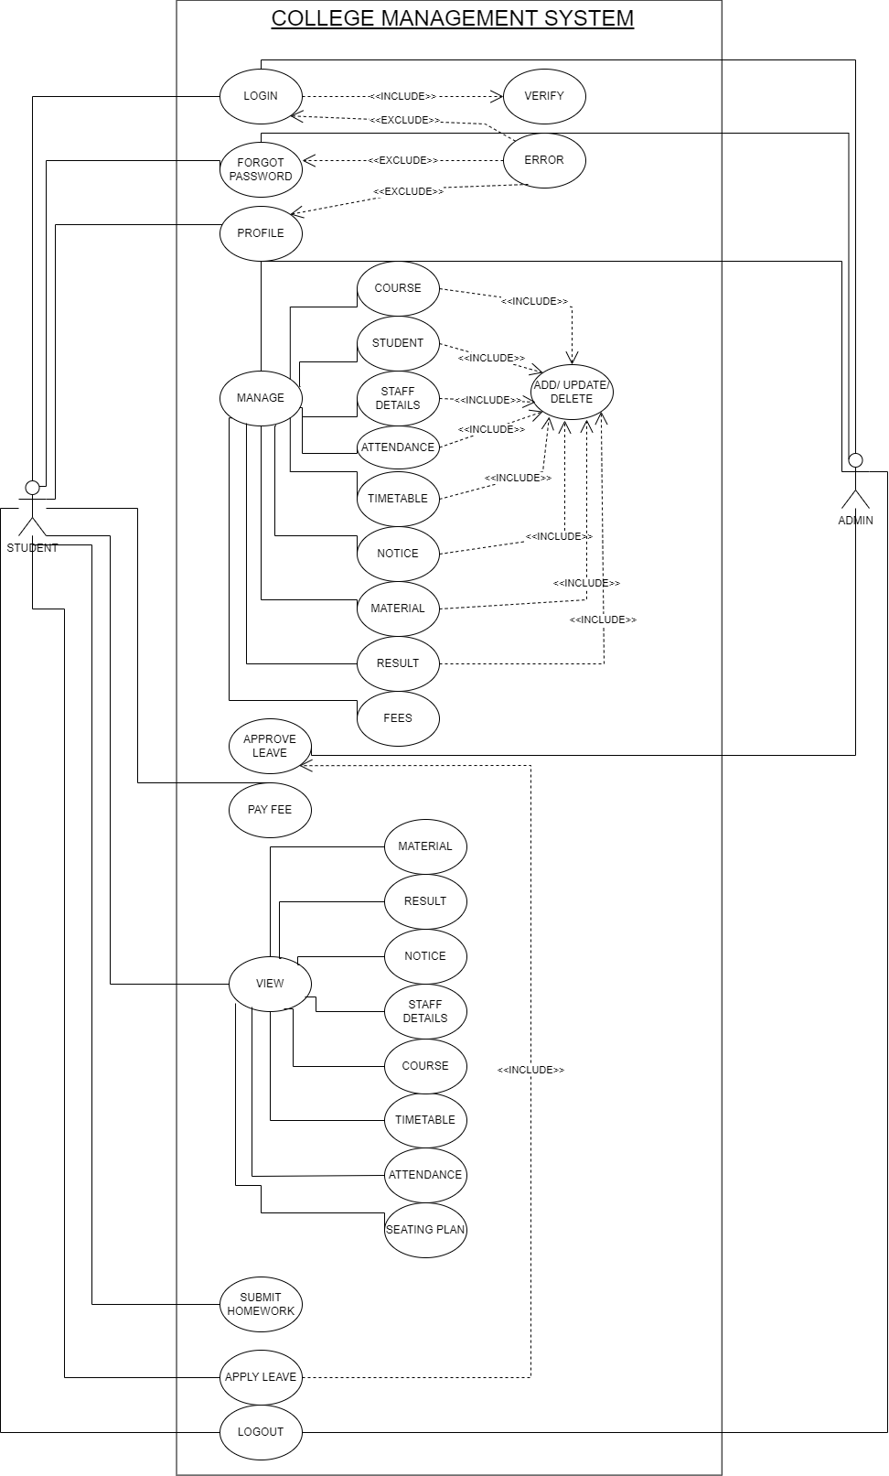
Use case diagram:

Slide 5
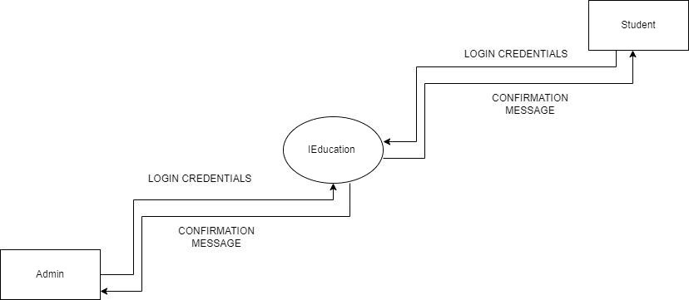
Level 0:

Slide 6
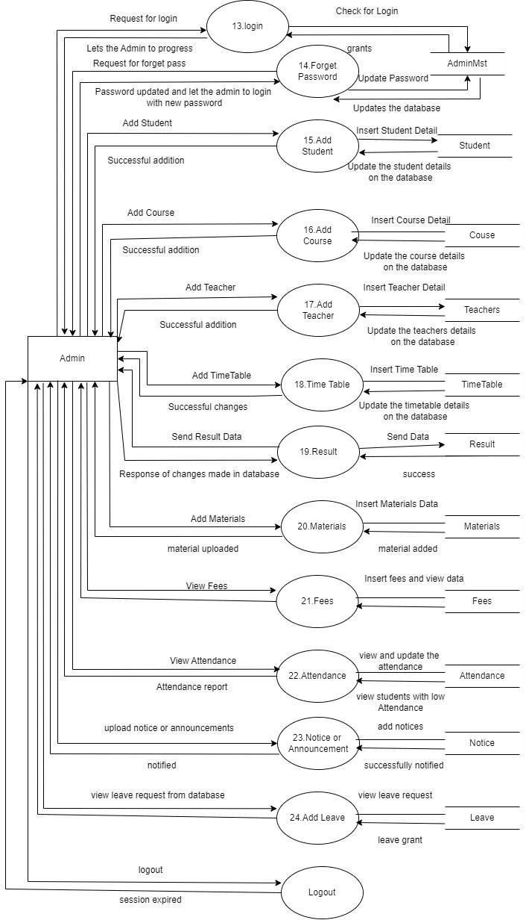
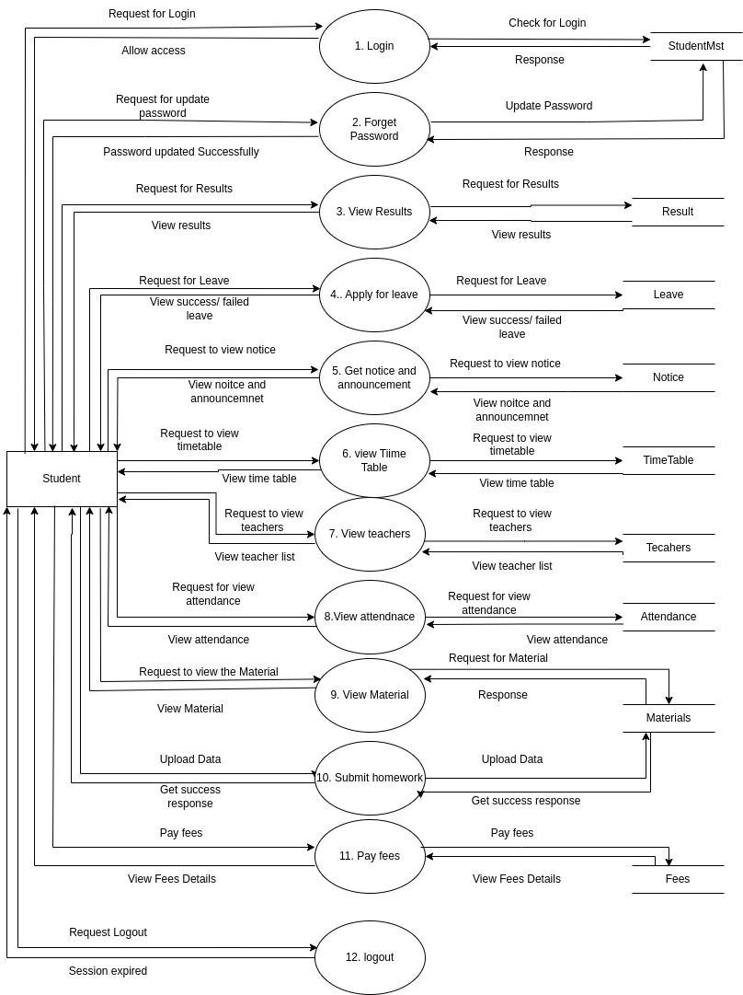
LEVEL 1:

Slide 7

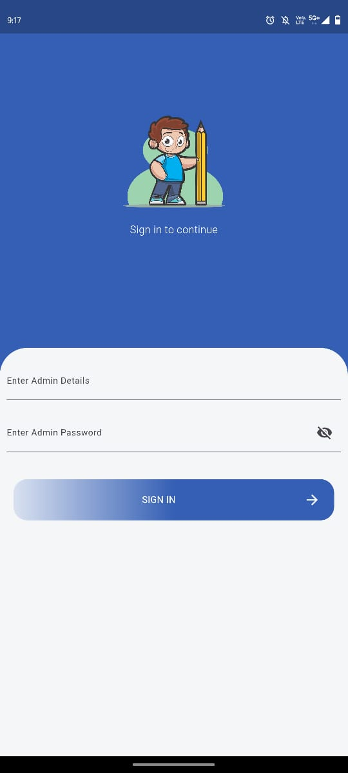
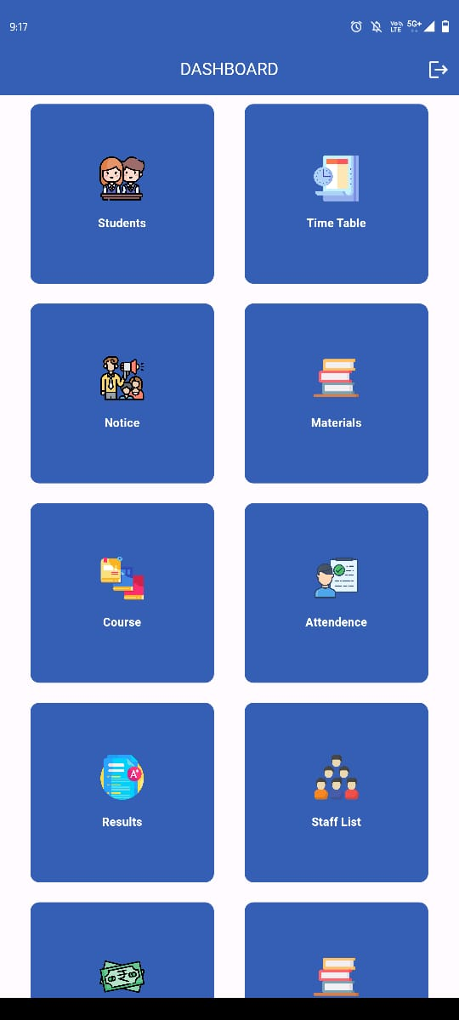
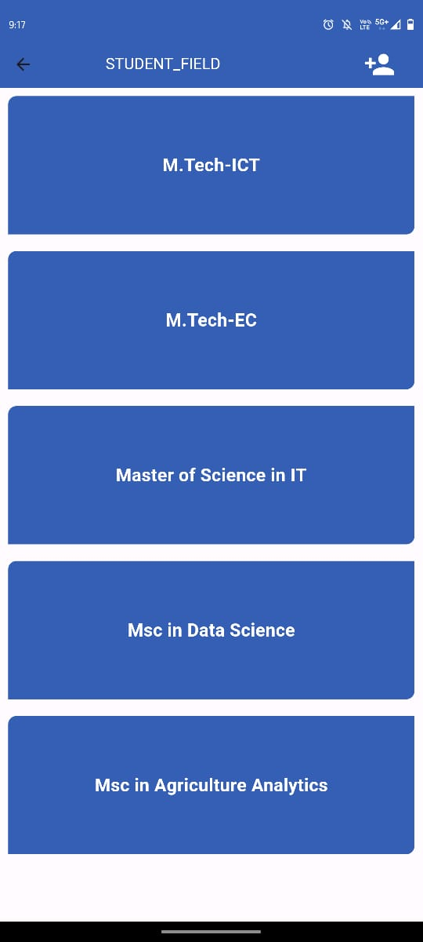
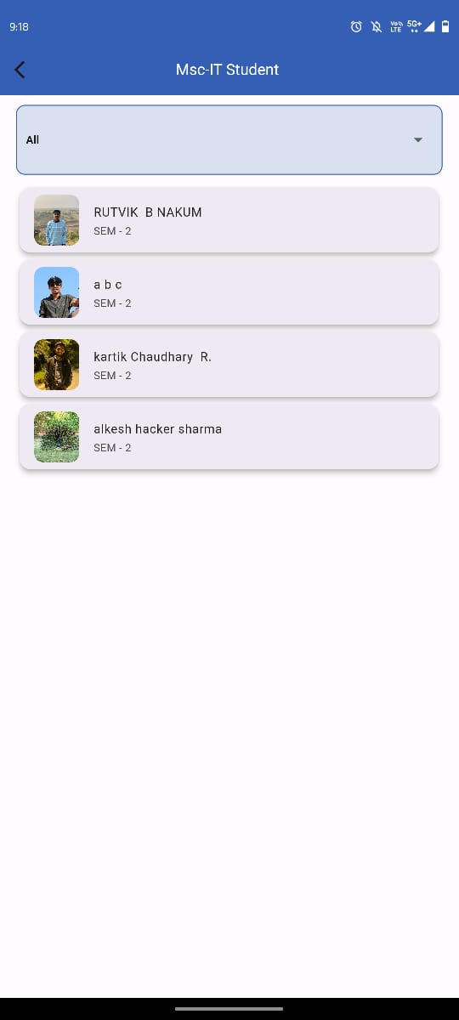
ADMIN SIDE SCREENSHOTS:

Slide 8
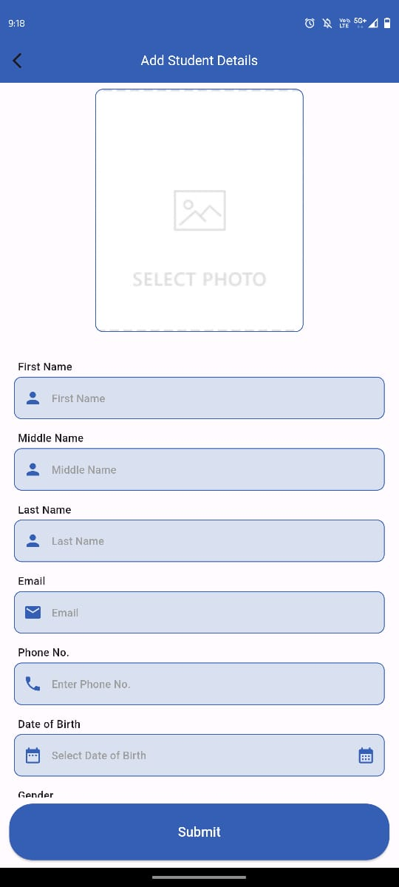
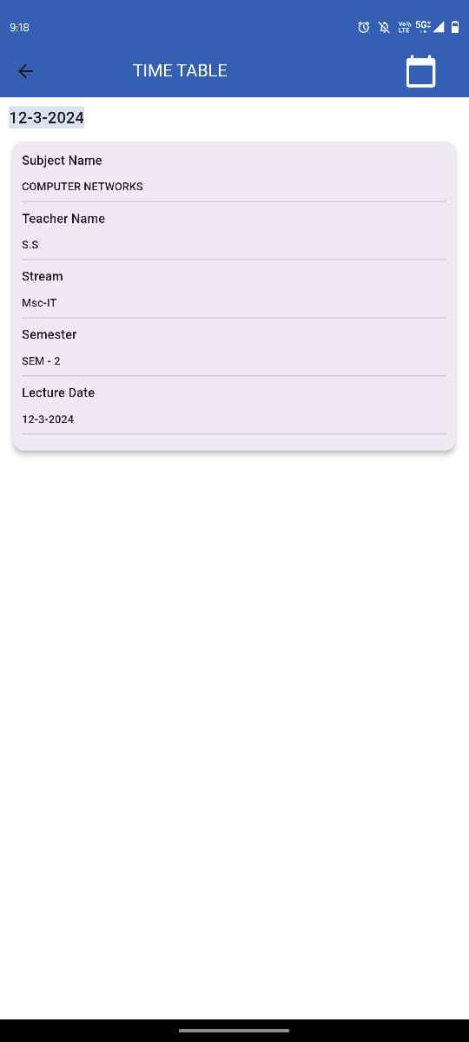
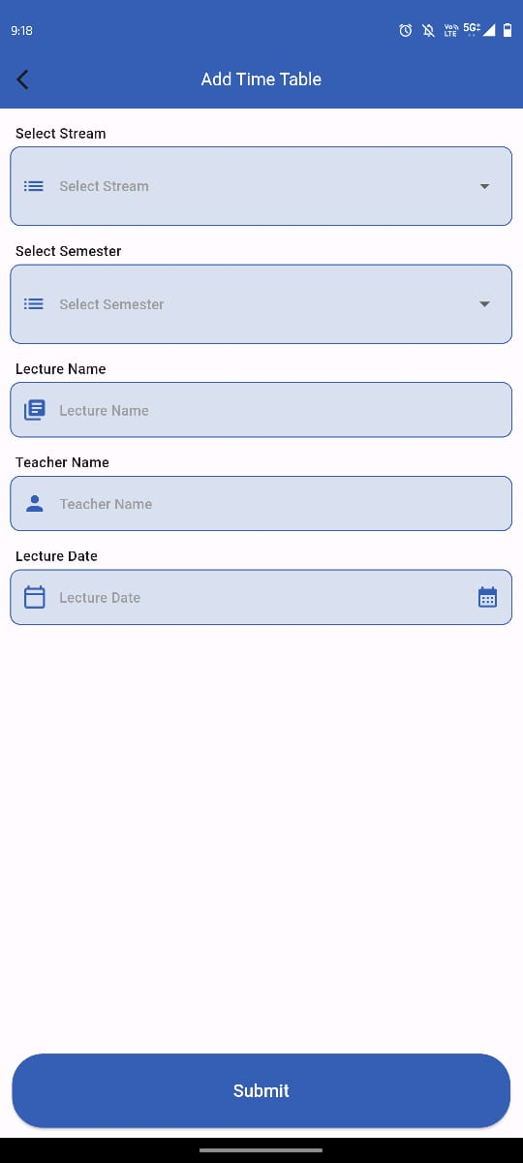
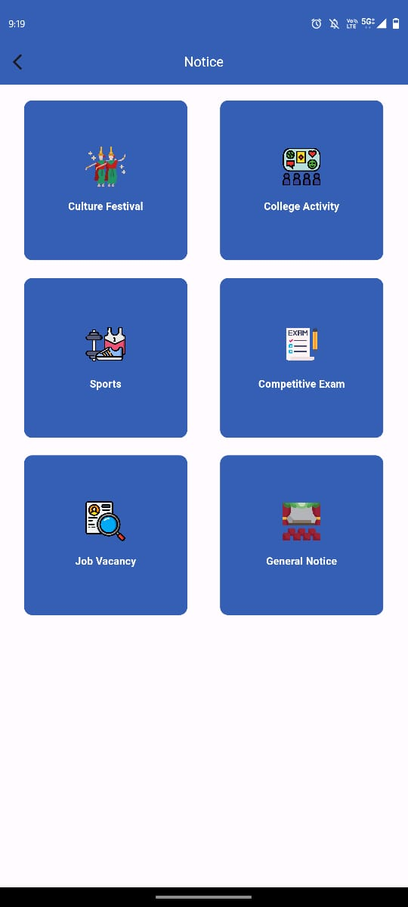
ADMIN SIDE SCREENSHOTS:

Slide 9
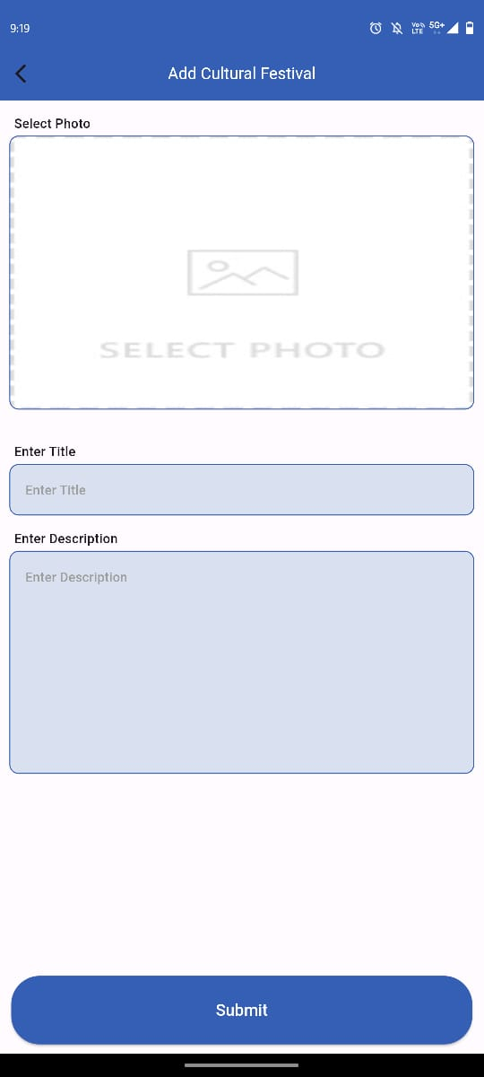

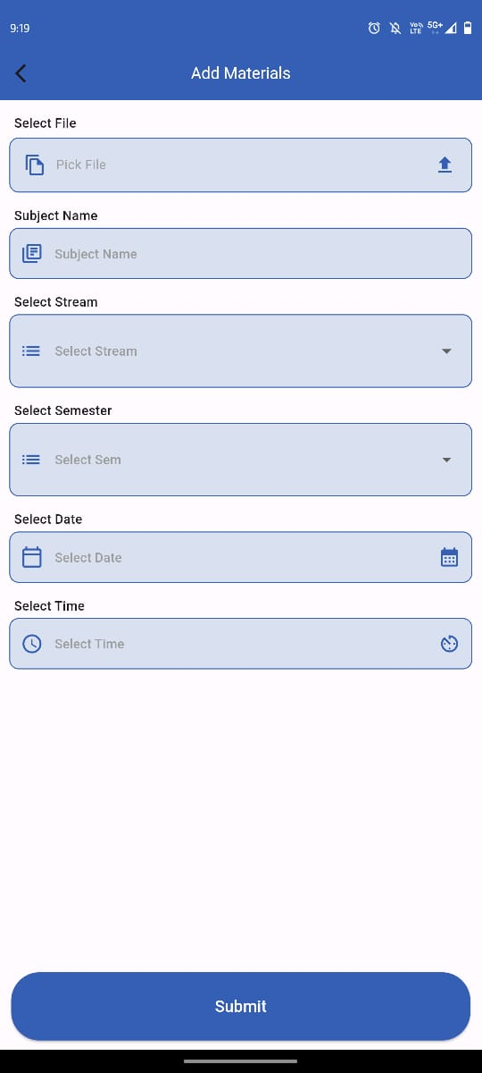

ADMIN SIDE SCREENSHOTS:

Slide 10
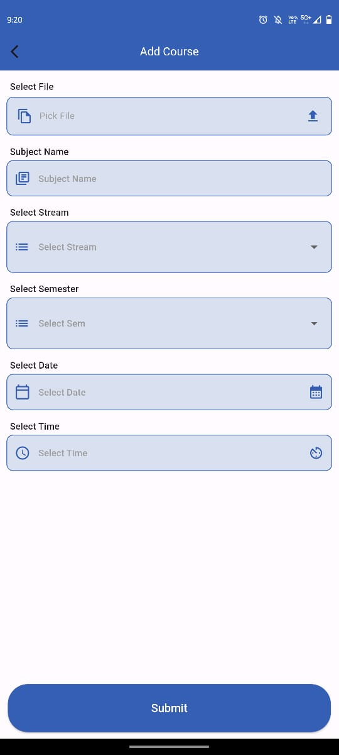

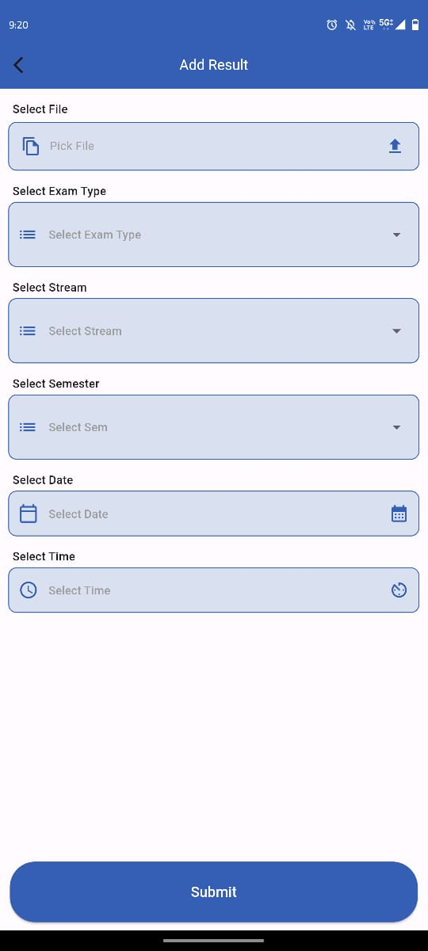
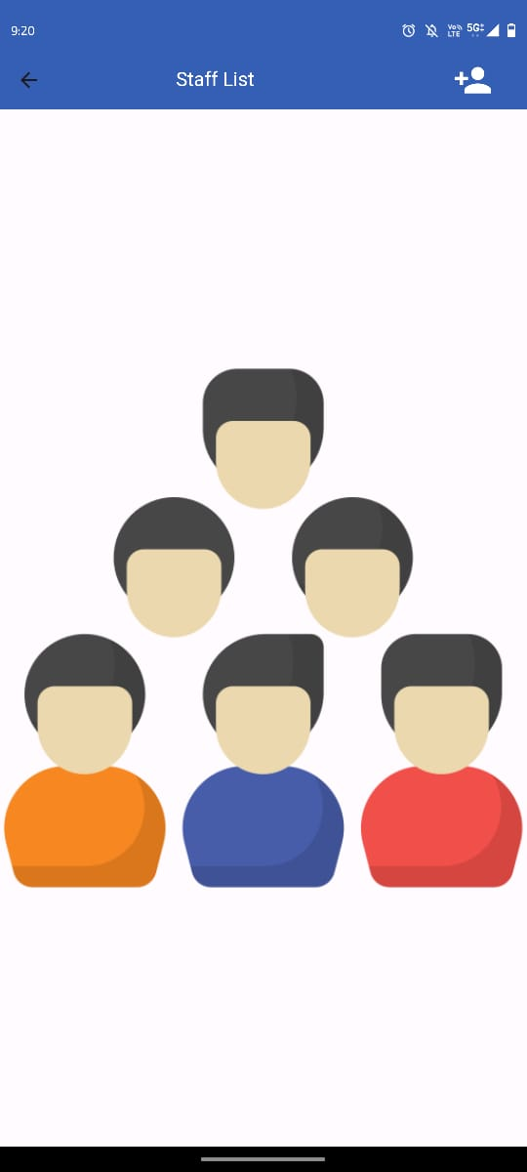
ADMIN SIDE SCREENSHOTS:

Slide 11
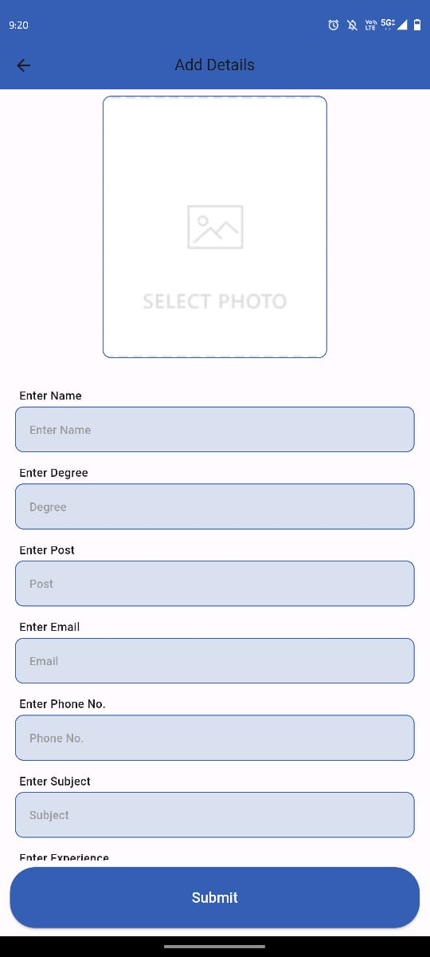
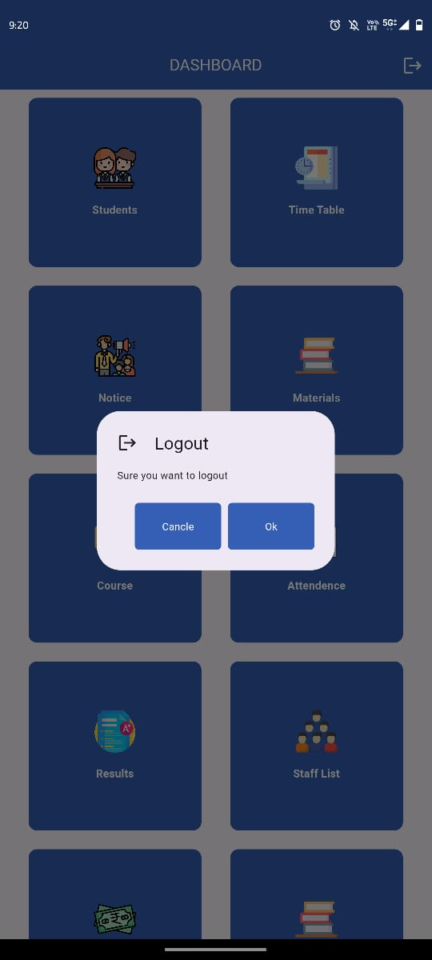
ADMIN SIDE SCREENSHOTS:

Slide 12
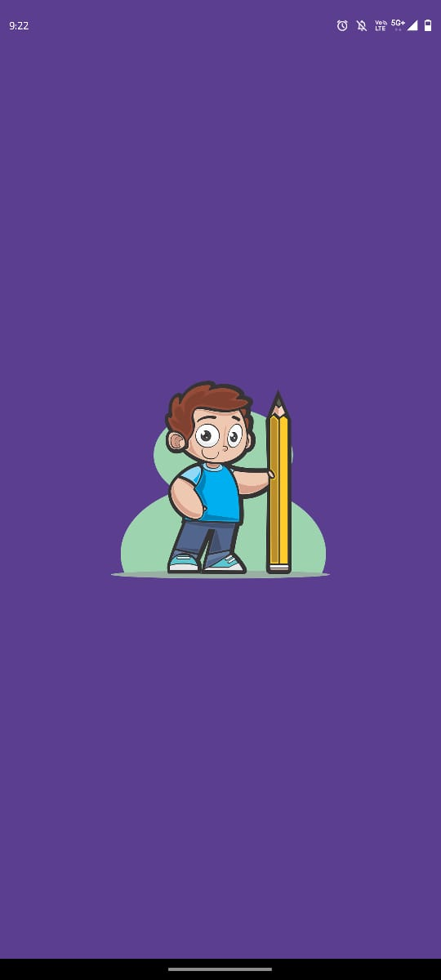
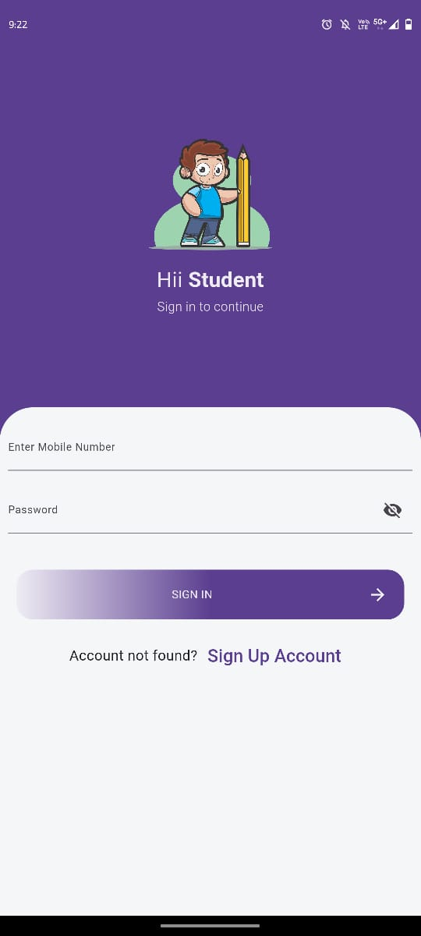
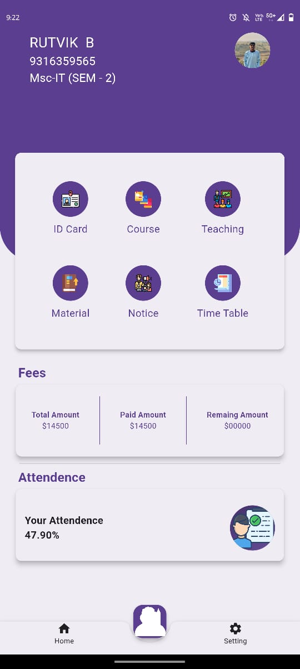
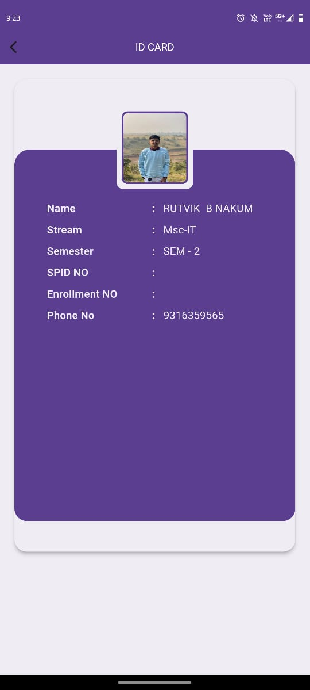
USER SIDE SCREENSHOTS:

Slide 13
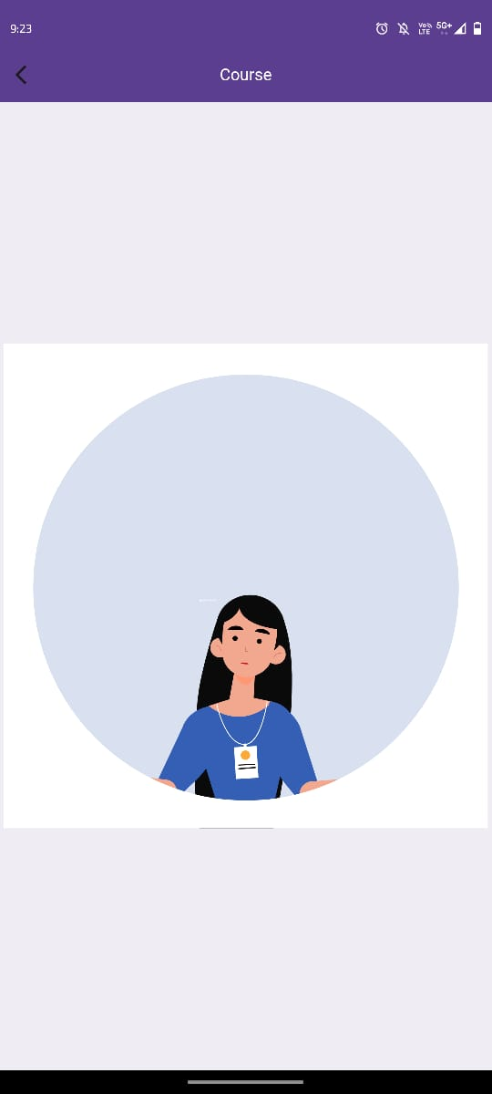
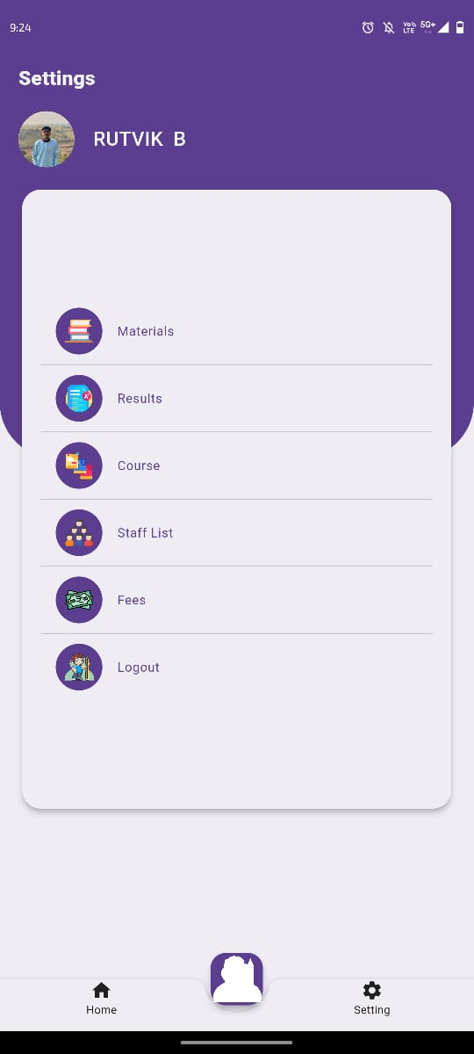
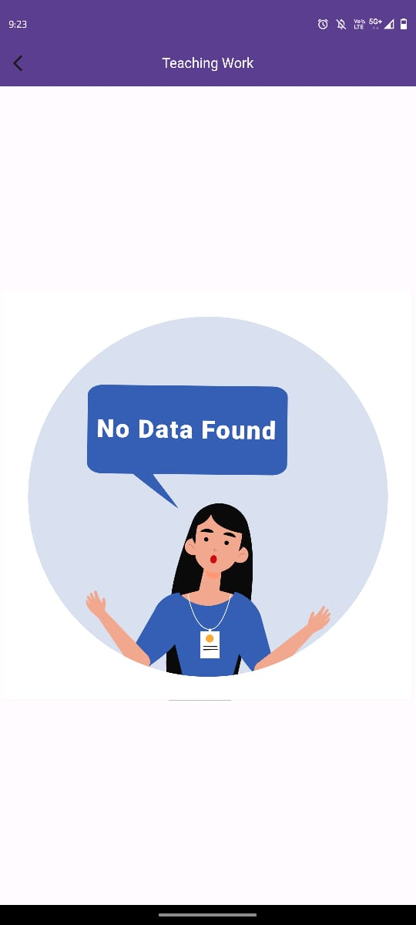
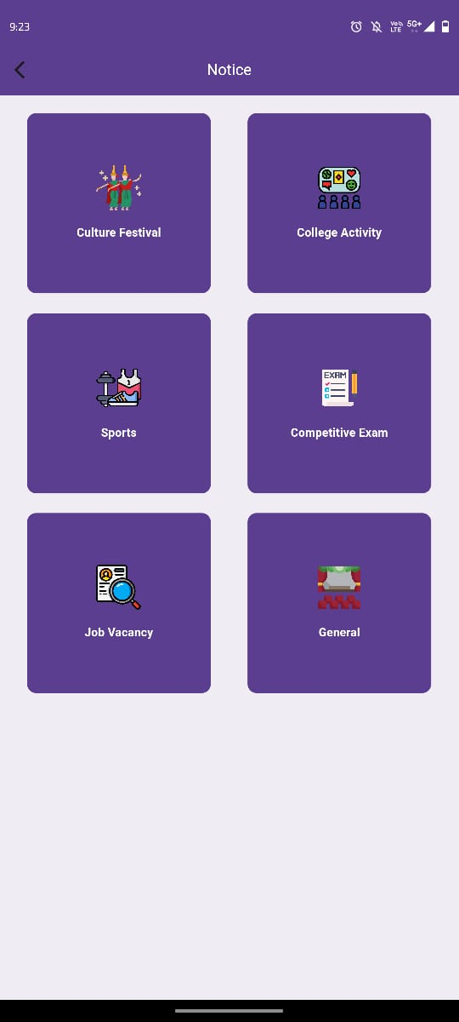
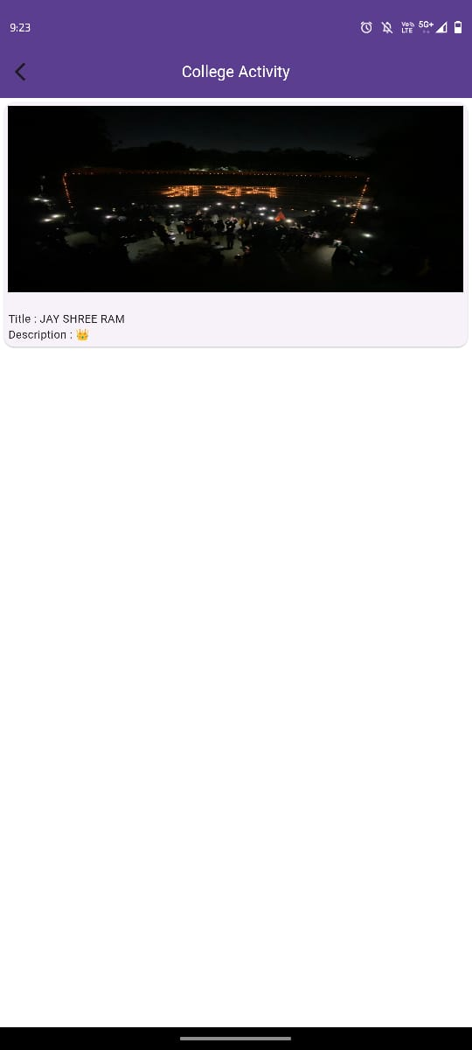
USER SIDE SCREENSHOTS:

Slide 14
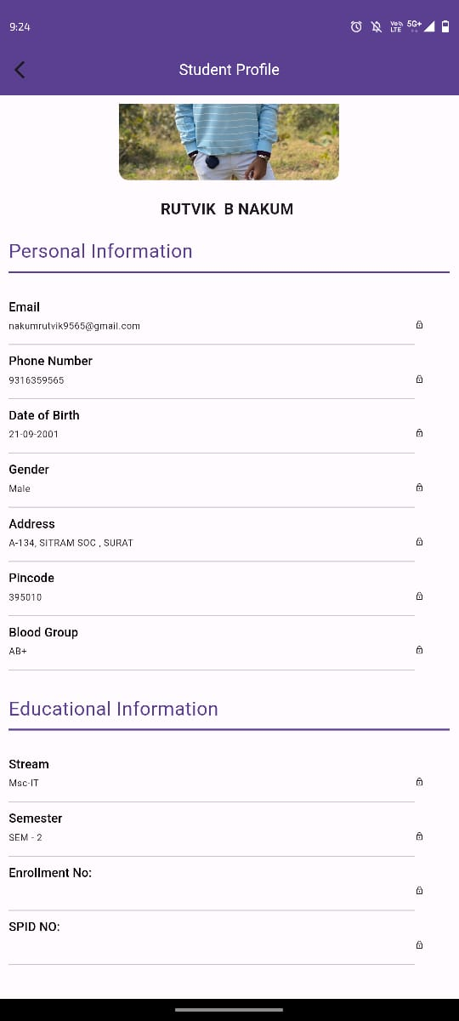
USER SIDE SCREENSHOTS:

Slide 15
Lessons learnt by doing the software project (or take away):
1.User-Centric Design : Prioritizing user needs and feedback throughout the development process is crucial for creating a system that is intuitive and valuable to its users. Incorporating features like password options and easy-to-use interfaces enhances user experience.
2.Security Measures : Implementing robust security measures, such as secure login processes and encrypted databases, is essential for safeguarding sensitive information and ensuring user privacy.
3. Effective Communication : Clear and frequent communication among team members, stakeholders, and users helps in understanding requirements, resolving issues promptly, and ensuring project alignment with expectations.

Slide 16
Lessons learnt by doing the software project (or take away):
4. Adaptability and Flexibility : Remaining flexible and adaptable to changing requirements, technology advancements, and unforeseen challenges is essential for successful project delivery. Being open to iteration and improvement fosters resilience and innovation.
5. Continuous Improvement : Embracing a culture of continuous improvement fosters innovation, drives efficiency, and ensures that the software remains relevant and valuable over time. Regular feedback collection and iteration based on user insights are key to staying ahead of evolving needs and expectations.

Slide 17
ACHIEVEMENTS:
1. Secure Authentication : Implemented secure login for admins and users.
2. Student Record Management : Developed efficient system for managing student details.
3. Dynamic Timetable : Created dynamic timetable system for course scheduling.
4. Notice & Announcement : Implemented categorized notice system for students and staff.
5. Study Material Sharing : Developed seamless system for sharing study materials.
6. Course Management: Efficiently managed course offerings, including updates and deactivation.
7. Attendance Monitoring : Implemented system for tracking student attendance.

Slide 18
MISTAKES.
1.Dependency Management Issues:
Conflicting Dependencies: Failure to manage dependencies properly caused conflicts between different parts of the system, leading to errors during compilation.
Outdated Dependencies: Neglected to update dependencies regularly exposed the system to security vulnerabilities or compatibility issues with other software components.
2. Database Design Flaws(Data Redundancy): Not normalizing the database properly resulted in redundant data storage, increasing storage requirements and potentially causing data inconsistency.

